Slide 1
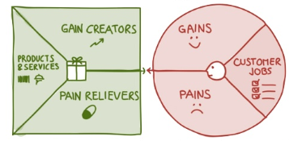

MSC3182
SOCIAL ENTREPRENEURSHIP
Lesson 3
How to create products and services customers want. Get started with…….
Value Proposition Design

Slide 2
OBJECTIVES
In this lesson, you will
Identify Jobs, Pains, and Gains, and Early Adopters

Slide 3

VALUE PROPOSITION DESIGN - INTRODUCTION

Slide 4


VALUE PROPOSITION DESIGN - INTRODUCTION
Why any product fail miserably?
Bad marketing
Product was not launched properly
Designed poorly
Many product failed because they overlooked the concept
Did the customer want it??

Slide 5
VALUE PROPOSITION DESIGN - INTRODUCTION
Other factors………. Many product failed because
What real purpose the product serve?
Real benefits did it offer?
Any real need or demand for it?
Who should really want such a device and spend money on it?
No satisfactory answer to these questions………….
Leads to think of important aspect of venture creation
“VALUE PROPOSITION DESIGN”

Slide 6



WHAT IS VALUE PROPOSITION DESIGN?
Your product must create value for your customers
Address the pain points and customers must want your product –
“PRODUCT & SERVICES MATCHES WHAT CUSTOMER WANTS “

Slide 7
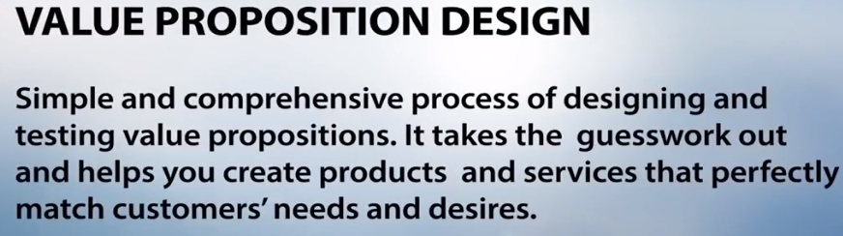
WHAT IS VALUE PROPOSITION DESIGN?

Slide 8
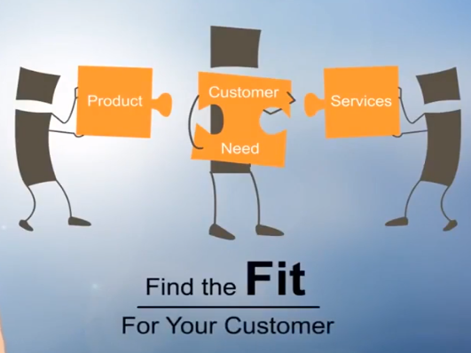
WHAT IS VALUE PROPOSITION DESIGN?

Slide 9
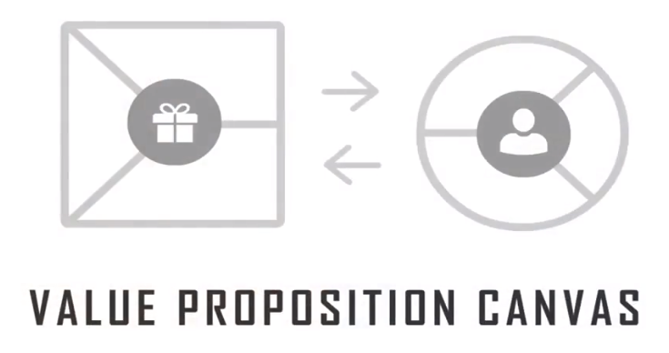
TOOL FOR VALUE PROPOSITION DESIGN

Slide 10
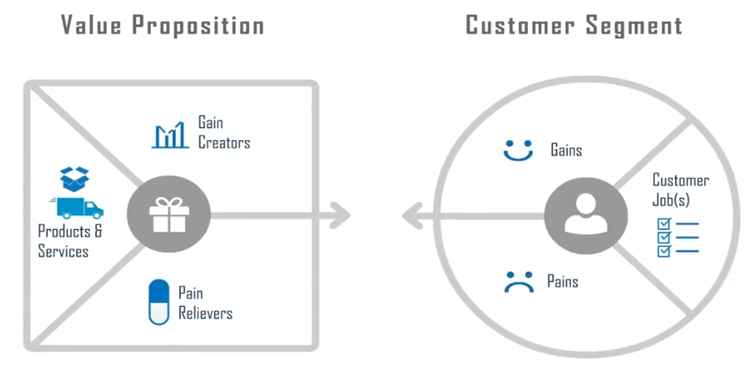
TOOL FOR VALUE PROPOSITION DESIGN

Slide 11
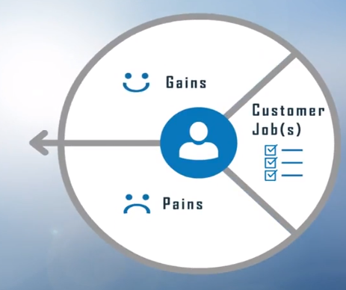
TOOL FOR VALUE PROPOSITION DESIGN

Slide 12
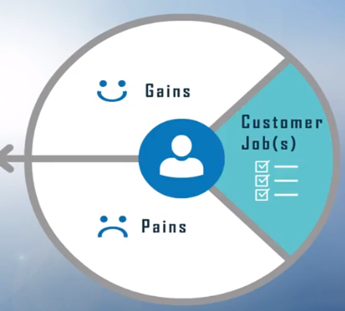
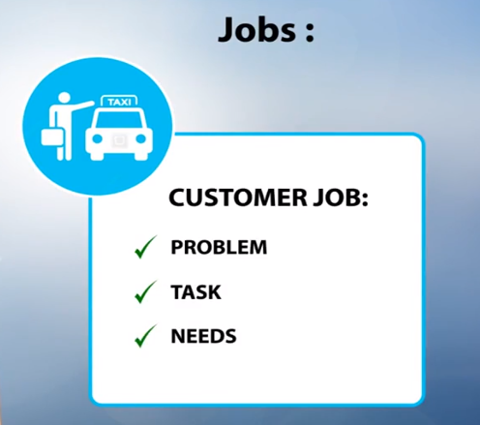
TOOL FOR VALUE PROPOSITION DESIGN
Simple things that the customers are trying to get done.

Slide 13
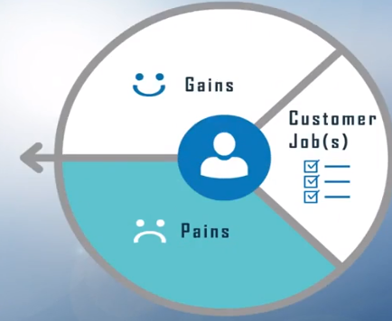
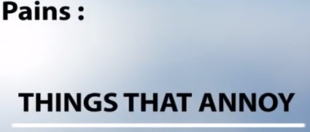
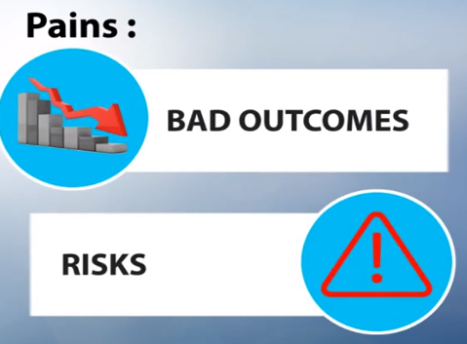
TOOL FOR VALUE PROPOSITION DESIGN
Prevents the customer from getting the job done

Slide 14
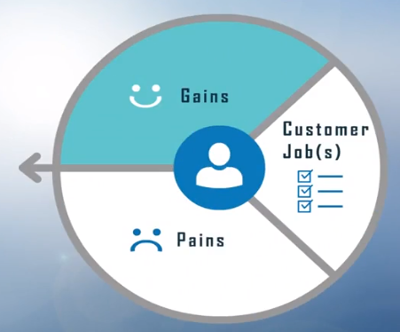
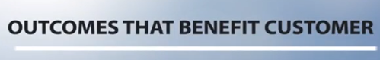
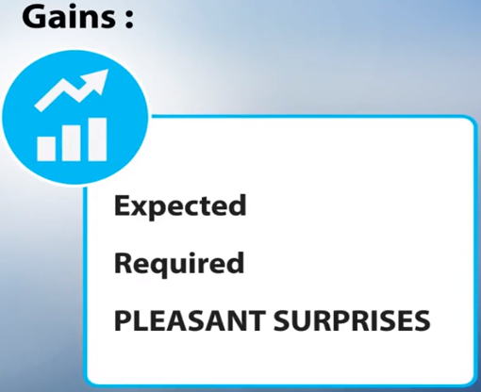
TOOL FOR VALUE PROPOSITION DESIGN

Slide 15

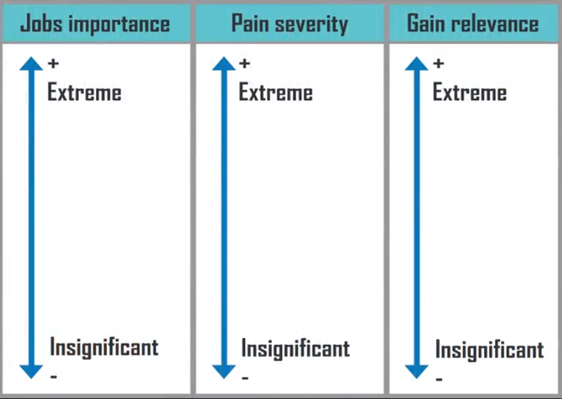
TOOL FOR VALUE PROPOSITION DESIGN

Slide 16
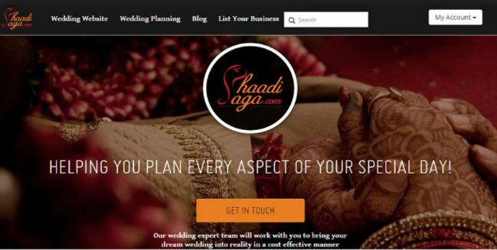
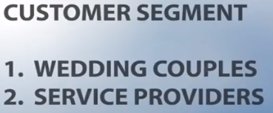
EXAMPLE FOR VALUE PROPOSITION DESIGN
Online wedding planning platform

Slide 17
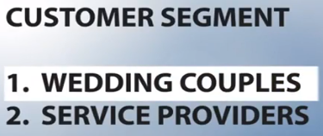
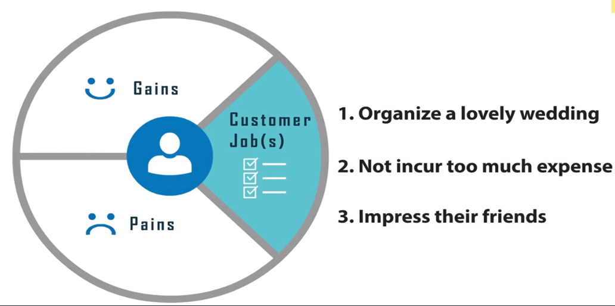
EXAMPLE FOR VALUE PROPOSITION DESIGN

Slide 18
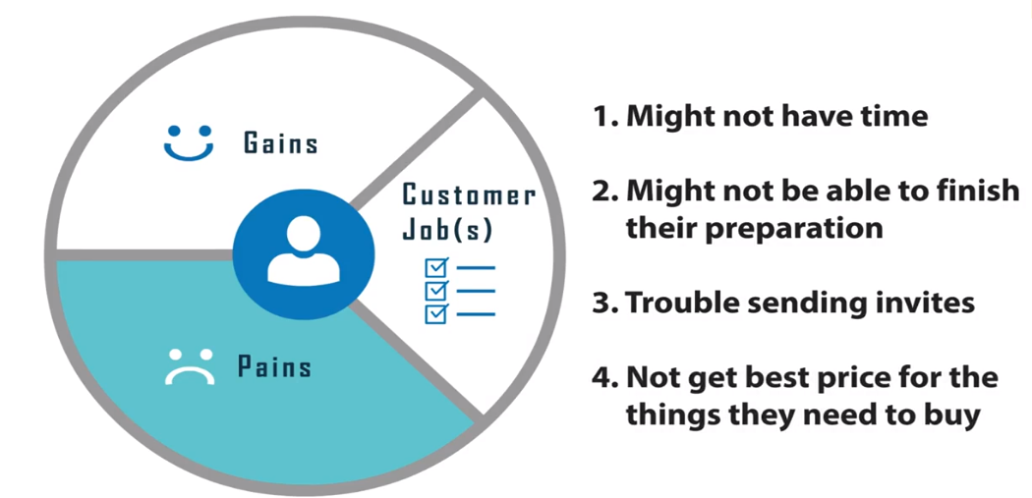
EXAMPLE FOR VALUE PROPOSITION DESIGN
Moderate
Extreme

Slide 19
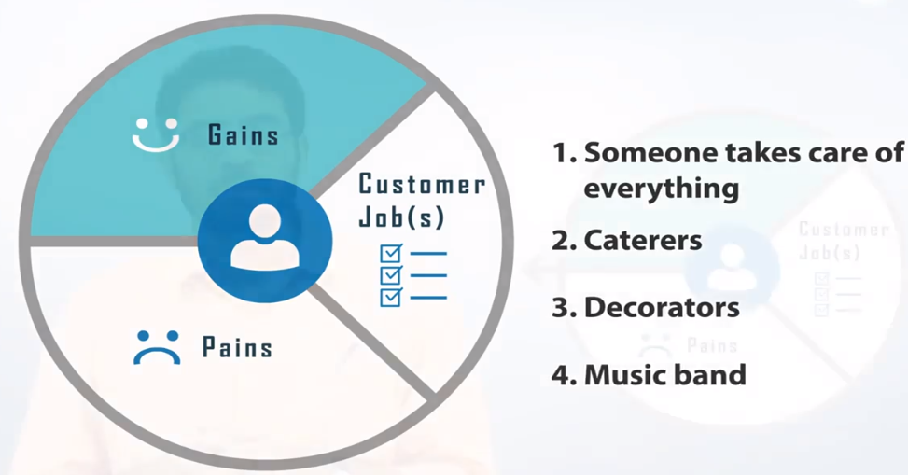
EXAMPLE FOR VALUE PROPOSITION DESIGN

Slide 20
CONCLUSION
DESCRIBE JOBS,PAINS AND GAINS CONCRETELY

